Slide 1




Superstore Sales Dashboard
An interactive Power BI report analyzing sales performance, profitability, and operational efficiency across regions, categories, and customer segments. This dashboard empowers management to monitor performance, analyze profit trends, identify high-performing areas, understand customer behavior, and optimize shipping strategies.

Slide 2


KEY METRICS
Performance at a Glance
1.57M
175K
22K
3.93
Total Sales
Total Profit
Units Sold
Profit Ratio
Strong revenue generation across all channels
Healthy profitability margins maintained
Strong product demand across categories
Excellent profit margins achieved
The company demonstrates strong overall performance with 1.57 million in total sales and a profit of 175.26K, indicating robust profitability. The quantity sold of 22,000 units shows strong product demand, while a profit ratio of 3.93 reflects healthy profit margins across the business.

Slide 3
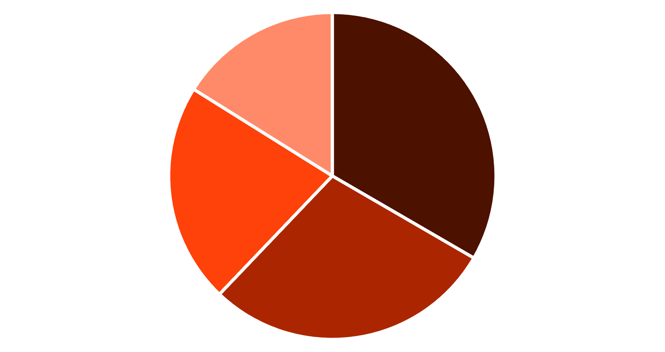

Regional Sales Performance
Regional Insights
West region leads as the top-performing region with 33.37% contribution. East and Central regions show moderate performance at 28.75% and 21.78% respectively. South region has the lowest contribution at 16.10%, presenting a growth opportunity.
West
East
Central
South

Slide 4
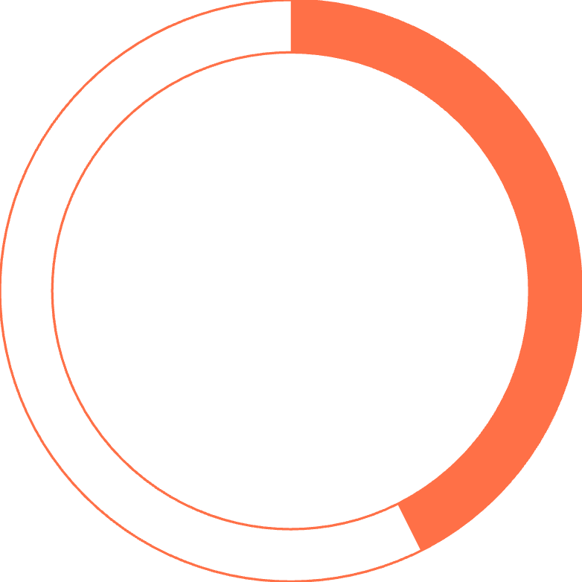
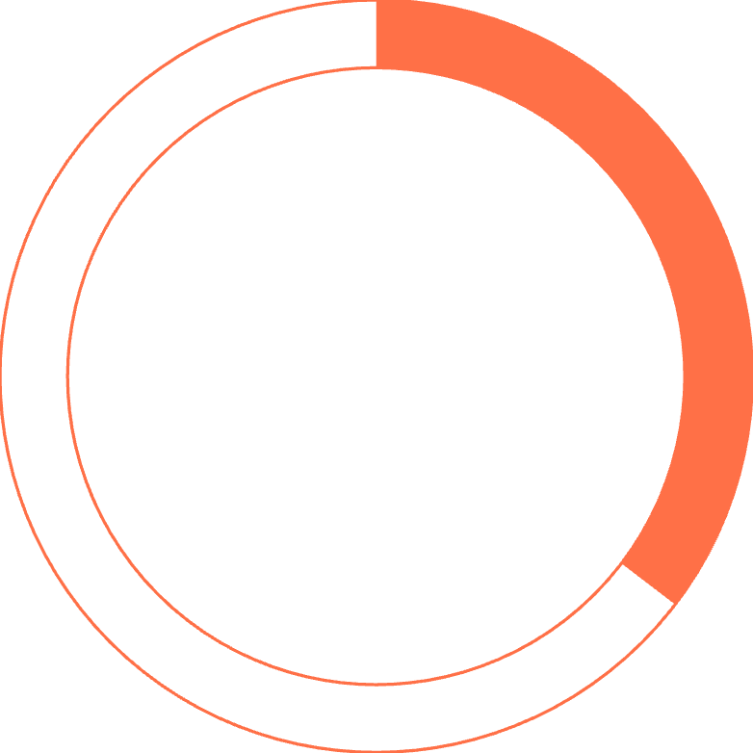
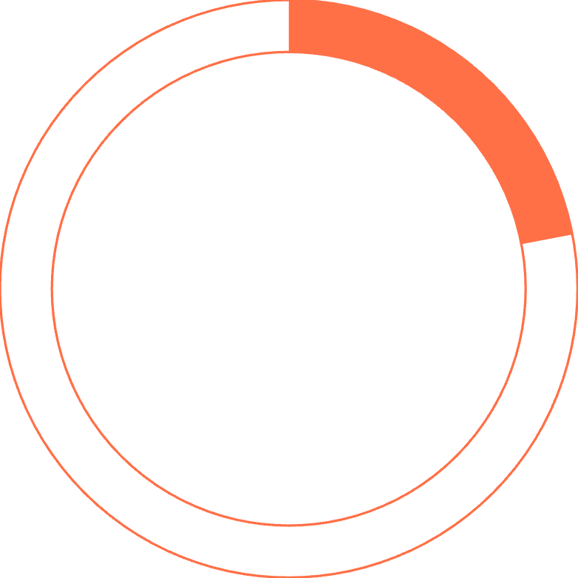


Customer Payment Preferences
42.62%
35.38%
21.99%
Cash on Delivery
Online Payments
Card Payments
Most preferred payment method
Growing significantly
Lowest usage currently
Recommendation: Encourage online payments through incentives to reduce cash handling risk and improve operational efficiency.

Slide 5


Sales by Customer Segment
Consumer
Corporate
48.09% contribution
32.55% contribution
Largest customer base driving revenue
Significant business segment
Home Office
19.35% contribution
Growth potential segment
The Consumer segment represents the largest customer base at 48.09%, followed by Corporate at 32.55%. The Home Office segment, while smaller at 19.35%, presents untapped growth potential.
Strategic Focus: Concentrate marketing efforts on Consumer and Corporate segments while developing targeted campaigns to expand the Home Office customer base.

Slide 6




Category Performance Analysis
Office Supplies
Technology
Furniture
0.64M in sales
0.47M in sales
0.45M in sales
Best-performing category driving maximum revenue
Strong performance with growth opportunities
Solid contributor to overall revenue
Recommendation: Expand Office Supplies inventory to capitalize on strong demand. Promote Technology products through targeted marketing to increase sales further.

Slide 7
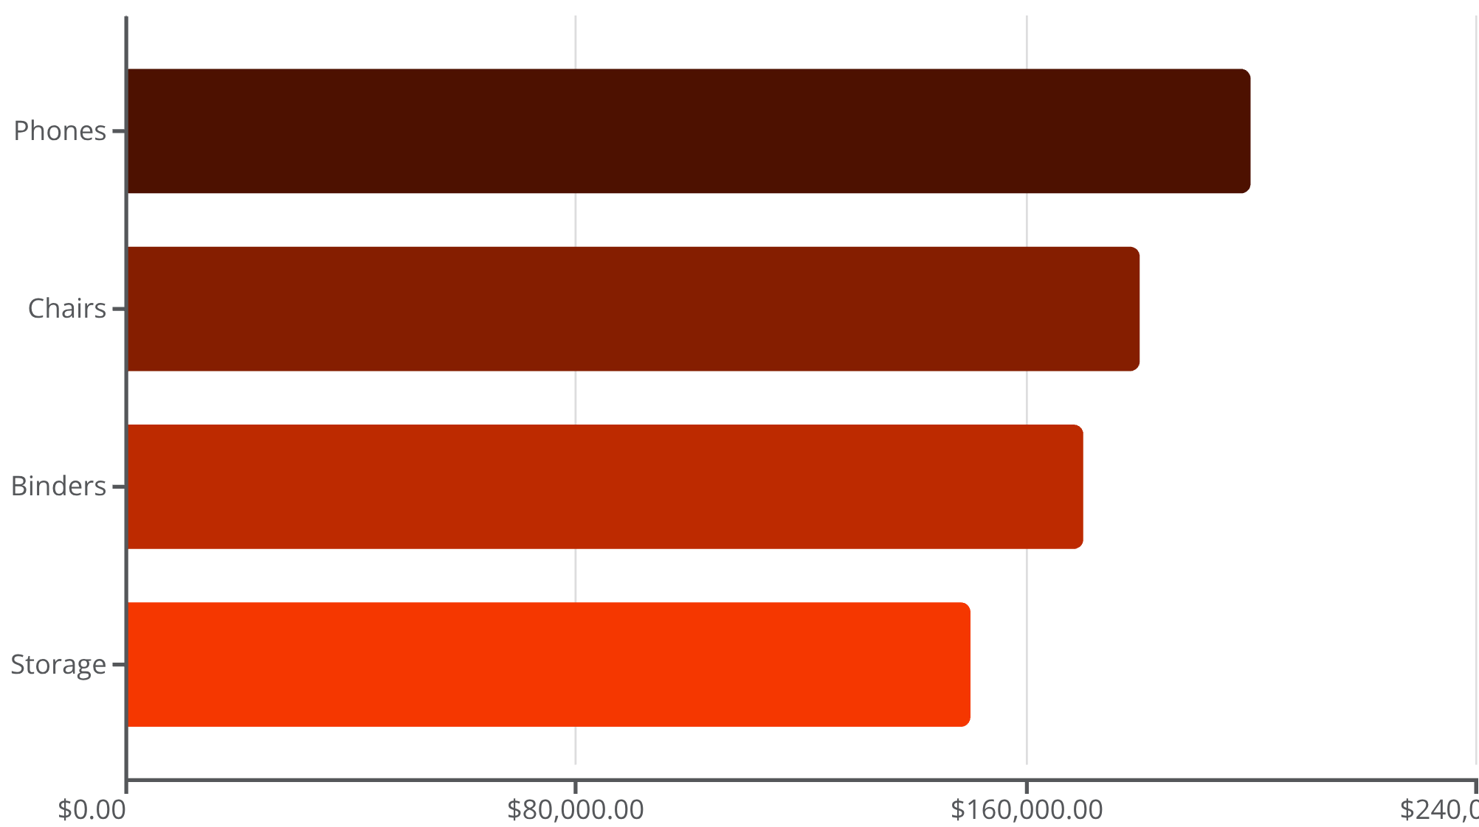


Top-Performing Sub-Categories
Revenue Leaders
Four sub-categories drive the majority of sales revenue across all product lines.
Phones generate the highest revenue at 0.20M, followed closely by Chairs and Binders. Storage solutions also show strong performance.
Strategic Action: Increase marketing investment for Phones and Chairs to maximize revenue from these high-performing products.

Slide 8





Shipping Mode Analysis
Standard Class
Second Class
First Class
0.42M in sales
0.15M in sales
0.10M in sales
Most used shipping method
Moderate usage
Premium option
Same Day
0.04M in sales
Least utilized
Standard Class dominates as the most used shipping method. Same Day delivery is underutilized, presenting an opportunity to improve marketing and customer awareness of expedited shipping options.

Slide 9


Sales & Profit Trends
Early Year
1
Lowest sales in January and February across both years
2
Mid-Year
Moderate performance with some profit fluctuations
Festive Season
3
Peak sales in October, November, December
4
Year-over-Year
Significant sales increase in 2020 vs 2019
Sales increased significantly in 2020 compared to 2019, with highest sales and profit observed during the festive season months of October through December. The festive season drives substantial demand increases. Profit trends show steady growth in 2020 with peak profitability in November and December.
Strategic Opportunity: Increase marketing investment before the festive season to maximize revenue during peak demand periods.

Slide 10


ACTION PLAN
Key Recommendations
1
Expand South Region
Run targeted regional promotions and improve distribution networks to capture untapped market potential
2
Promote Top Products
Focus marketing on Phones, Chairs, and Office Supplies to maximize revenue from high-performing categories
3
Drive Digital Payments
Offer incentives for online payments to reduce cash handling risk and improve operational efficiency
4
Optimize Shipping
Improve Same Day delivery services and marketing to capture premium shipping revenue
5
Leverage Seasonality
Increase marketing investment before festive season to capitalize on peak demand periods
The Superstore Sales Dashboard reveals strong overall performance with 1.57M in sales and healthy profitability. By focusing on underperforming regions, improving payment methods, and promoting high-demand products, the company can further increase sales and profitability.

